Slide 1

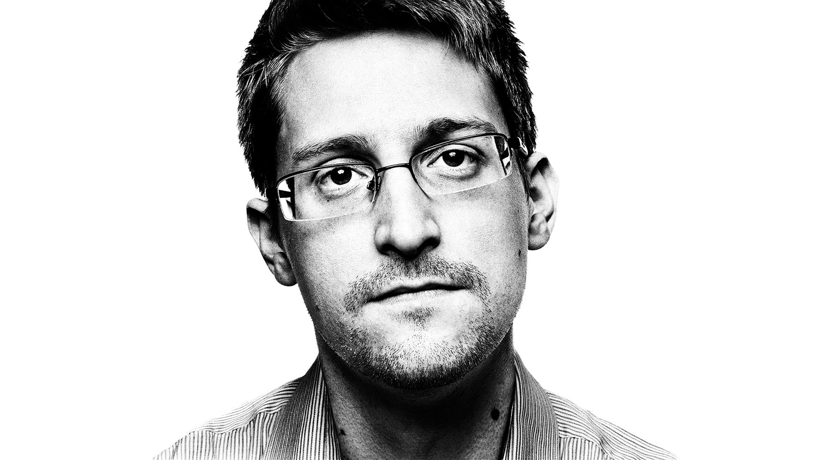




Edward Snowden & Global Surveillance:
On June 5th, 2013 it was revealed to the world that the National Security Agency (NSA) had been secretly observing the world’s digital lives.
Surveying phone records, accessing Google and Yahoo account holders’ emails and even the creation of the PRISM program have been attributed to the secretive agency. All exposed by one whistle-blower, Edward Snowden.
"My sole motive is to inform the public as to that which is done in their name and that which is done against them.“ – Snowden, 9th June 2013

Slide 2
What happened?
5th of June, 2013, first NSA documents released.
Solid proof of surveillance laws being broken for years.
NSA invading the lives of people all around the world.
14th June 2014 US federal prosecutors filed a criminal complaint against Snowden.
Snowden charged with;
theft of government property
2 counts of violation of the Espionage act.
An “arcane World War 1 law” which “effectively hinders a person from defending himself before a jury in an open court” [Jesselyn Radack]
A law made not for whistleblowers but spies who sold secrets to the enemy. Snowden remains in Russia under “right of asylum” until at least 2020 and continues to seek further asylum.
Notes:
On the 5th of June, 2013, Snowden released the first NSA documents of his secret-exposing campaign. These documents were solid proof that the NSA had been breaking surveillance laws for years, invading the lives of people all around the world. Despite this, by the 14th June 2014 the US federal prosecutors filed a criminal complaint against Snowden, charging him with theft of government property and two counts of voilation of the Espionage act, an “arcane World War 1 law” which “effectively hinders a person from defending himself before a jury in an open court” [Jesselyn Radack] , made not for whistleblowers but spies who sold secrets to the enemy. Snowden remains in Russia under “right of asylum” until at least 2020 and continues to seek further asylum.

Slide 3
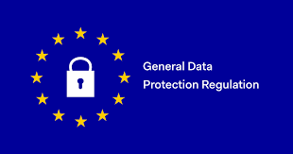
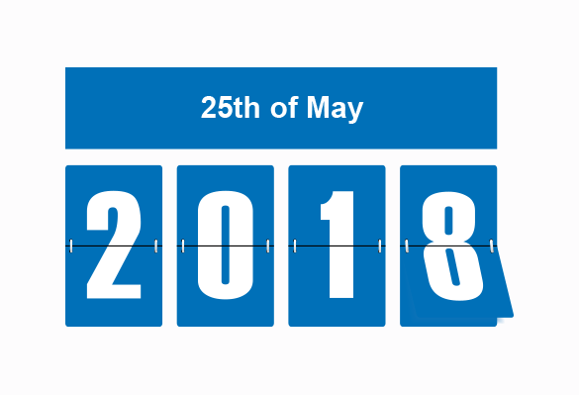
Issues Raised in the Lecture:
GDPR – General data protection regulations
Coming into power 25th May 2018
Give control back to citizens and residents regarding how their personal data is acquired, stored, secured and processed. It also gives citizens the right to access, challenge and amend their data.
Replace the outdated Data Protection Directive by factoring in new technologies and emerging platforms, such as social media and cloud computing.
Create a single unified regulation across the EU to replace the various interpretations of the previous directive.
The financial penalty put in place is steep – a fine of 20 Million EUROS or 4% the organization's global turnover (whichever amounts to more). Roughly 17 million pounds

Slide 4
GDPR links to Snowden:
Frederico Do Nascimento Costa believes the Snowden relations created a need in the EU to protect the individual.
Almost immediately after the EC began to draft the GDPR in 2012, Snowden leaked the information about the NSA
Sparked other investigations e.g. investigations into Facebook’s European privacy
Snowden’s revelations made the need for data protection reform more pressing.
Snowden brought the issue of privacy versus security to the forefront of public discourse.
He highlighted that data security is complex, multi-dimensional, and at times, it would appear, beyond the control of those handling the data.
As Snowden pointed out, the reality that he, “a 29-year-old contractor could walk out of the NSA with an untold number of documents and they didn’t know about it until he was on TV, should give us pause.”

Slide 5

Lecture Issues: Cyber crime
Cyber crime is crime involving a computer and a network. The computer may have been used in the commission of a crime, or it may be the target
In 2015, 74% of Small and medium-sized enterprises (SME’s) reported a cyber security breach in the past year – a number which is expected to rise
Forbes estimate that by 2019, the complications of cyber-crime will soar to $2 trillion - Two trillion dollars!

Slide 6
Cyber crime link to Snowden:
Edward Snowden is seen by many as hero, but that doesn’t mean he didn’t commit a crime.
Date-breaches aren’t always due to fault hardware/software or leaving a hole open for hackers to exploit
As shown in the Snowden case – Social engineering and the human ‘factor’ are major contributors
Whether he was a hero or a traitor or a peacekeeper is all relative, the fact is that one man managed to expose all this information, just by downloading the data onto an external hard drive
When it comes to cyber-security, prevention is the best cure
Therefore governance and regular patching is important for an organisations systems. As is employee training and awareness.
Can’t expect all employees to be a trained specialist in dealing with cyber-security and the risks
Therefore must make it easier for them by making it more difficult for them to send a classified document to external contacts and more challenging for anyone to access their devices
Snowden may or may not be a true peace patriot, but either way, it’s imperative to ensure organisations aren’t left with the same level of exposure as the NSA.

Slide 7
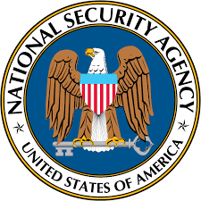
National Security issues in relation to the Internet of things:
NSA’s surveillance has some stark similarities to the Internet of Things (IoT).
Both encourage the almost indiscriminate collection of data
and secondly, both are based on the notion that collected data will be stored, perhaps indefinitely, in the event that it needs to be referenced later.
Both of these notions raise serious concerns for the IoT that are centered around one question: Does the fact that we can collect data, mean that we should?
A challenge of indiscriminate data collection is the dark side of Big Data.
Analyzing countless bytes of structured and unstructured data in an attempt to extract trends and “valuable insights” from the IoT has proven difficult even for some of the most advanced organizations on Earth
E.g. as Snowden said, the NSA “collected everything in a giant bucket” which is the reason the “surveillance programs have not been effective.”
“What the programs are doing is building a haystack of human lives, and you’ll find data that looks like needles, but isn’t,” he explained. “We collected it all instead of what was necessary. This didn’t achieve our goals.
Here, the lesson for IoT organizations should be clear: Sensor data can be indiscriminately acquired, though the complications of data analytics should make doing so a non-starter.

Slide 8
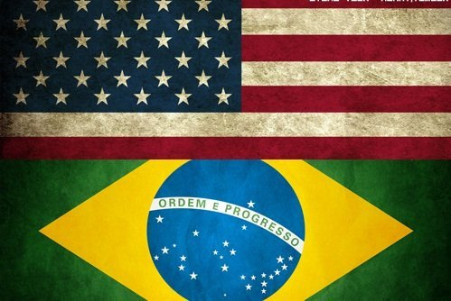
Professional Implications:
Examples of the professional implications:
Boeing and Brazil:
$4.5 billion deal between Brazil and U.S. terminated due to the hack.
Negotiation for over 10 years for supplying the Brazilian air force with 36 jets by 2020.
The contract went to Saab (Swedish company).
The cloud:
“57% of senior IT leaders cited data security as a major concern in 2013, which rose to 61% in 2014.”
“10% of non-US business have pulled from contracts with US cloud providers after the Snowden leak”
Cloud Industry Forum survey asked 205 UK IT staff and business execs about cloud usage:
Almost 10% changed cloud providers.
59% had mild to extreme concern for corporate data in the cloud.
Notes:
Intro: The leak / hack, depending on how you see it has had a massive impact on business and the way people treat information (even more so now with the net neutrality bill in America). The trust in US based security professionals was also degraded after it was revealed that the NSA has pushed for flawed security standards. This will impact the status and US based security professionals in the future. A none partisan group has stated that the originally $35 billion loss in foreign customers is far too low. The leaks directly influenced US international relations in a negative manner. Such as, Ecuador renouncing US trade benefits and Brazil cancelling a state visit. Furthermore,
Boeing:
A $4.5 billion deal between Brazil and the U.S. terminated due to the hack.
Had been in negotiation for over 10 years for supplying the Brazilian air for with 36 jets by 2020.
The contract went to Saab, a Swedish company. Saab has since gone bankrupt and bought over by the National Electric Vehicle Sweden (NEVS) on the 13th June 2012.
The cloud:
Due to the leak we saw a massive concern for security from senior IT leaders, such as a 4% jump between 2013 and 2014. We also saw that a lot of non-U. S businesses have pulled back from U.S. based cloud provider contracts.
Furthermore, a survey conducted by the cloud industry forum of 205 IT staff and business execs about cloud usage found that almost 10% of them had changed cloud provider and that 59% had mild to extreme concerns for corporate data being stored in the cloud.

Slide 9
Social Implications:
Examples of the social implications:
Boeing and Brazil:
Strained relationship between US and Brazil.
Brazilian source “The NSA’s problem ruined it for the Americans”.
The cloud:
Cloud Industry Forum survey asked 205 UK IT staff and business execs about cloud usage.
1/3 said because of the revelations they changed data security measures.
The effect of the leak on the public:
Of the 87% of American adults that were aware of Snowdens leaks.
1/3 changed their internet or phone habits as a result.
13% avoided using certain terms online.
14% said they were having more conversations face to face instead of over the phone.
Increased concerns of privacy
Notes:
Boeing and Brazil:
As a direct result of the leak there has been a massive strain on the relationship between the U.S.A and Brazil. This relationship has strong and attractive opportunities for the U.S; especially with growing troubles around the world. Brazil is the second largest economy in the Western Hemisphere and is a powerful ally. With the middle class of Brazil growing, a big deal with the U.S. would have been a massive boost for their economy.
The cloud:
In the same study they found that 1/3 had changed their data security measures due to the revelations.

Slide 10
Social Implications:
Examples of the social implications continued:
Americans view on Snowden:
55% believe he did the right thing.
29% believe he didn’t do the right thing.
16% don’t endorse either statement.
80% of his supporters said he exposed constitutional violations.
How has the leak left the public:
82% believe information is still being monitored by the U.S government.
51% say their employer has taken steps to make sure corporate files are secure.
20% decline in page views on Wikipedia articles related to terrorism.
40% of Americans were very or somewhat concerned that the government was spying on their online activities (2015).
Notes:
The leak left a lot of America, but also the world, rather divided on Snowdens actions. Of the 87% of Americans that were aware of the leak 1/3 said that they had changed their internet or phone habits as a result. 13% avoided using certain terms online and 14% said they were having more conversations face to face instead of over the phone. This shows that not too many were really all that concerned, but however just under a quarter of Americans felt a massive invasion of their privacy and are worried of their security of information / privacy. That’s just under 48 and a half million people.
So how do the Americans feel about Snowden, 55% believe he did the right thing, 29% believe he didn’t do the right thing and 16% endorse neither statement. Furthermore, 80% of his supporters said he exposed constitutional violations. So just above half the population thinks Snowden did the right thing but only 80% believe the leak was exposing violations.

Slide 11
Legal and Ethical Implications Examples:
Examples of the Legal implications:
Snowden charged with;
theft of government property
2 counts of violation of the Espionage act.
He can also not return to America otherwise he will be arrested with the charges above.
Examples of Ethical implications:
Leaked the uncovered illegal and unconstitutional behaviour, however he leaked it illegally without going through the legal channels provided.

Slide 12
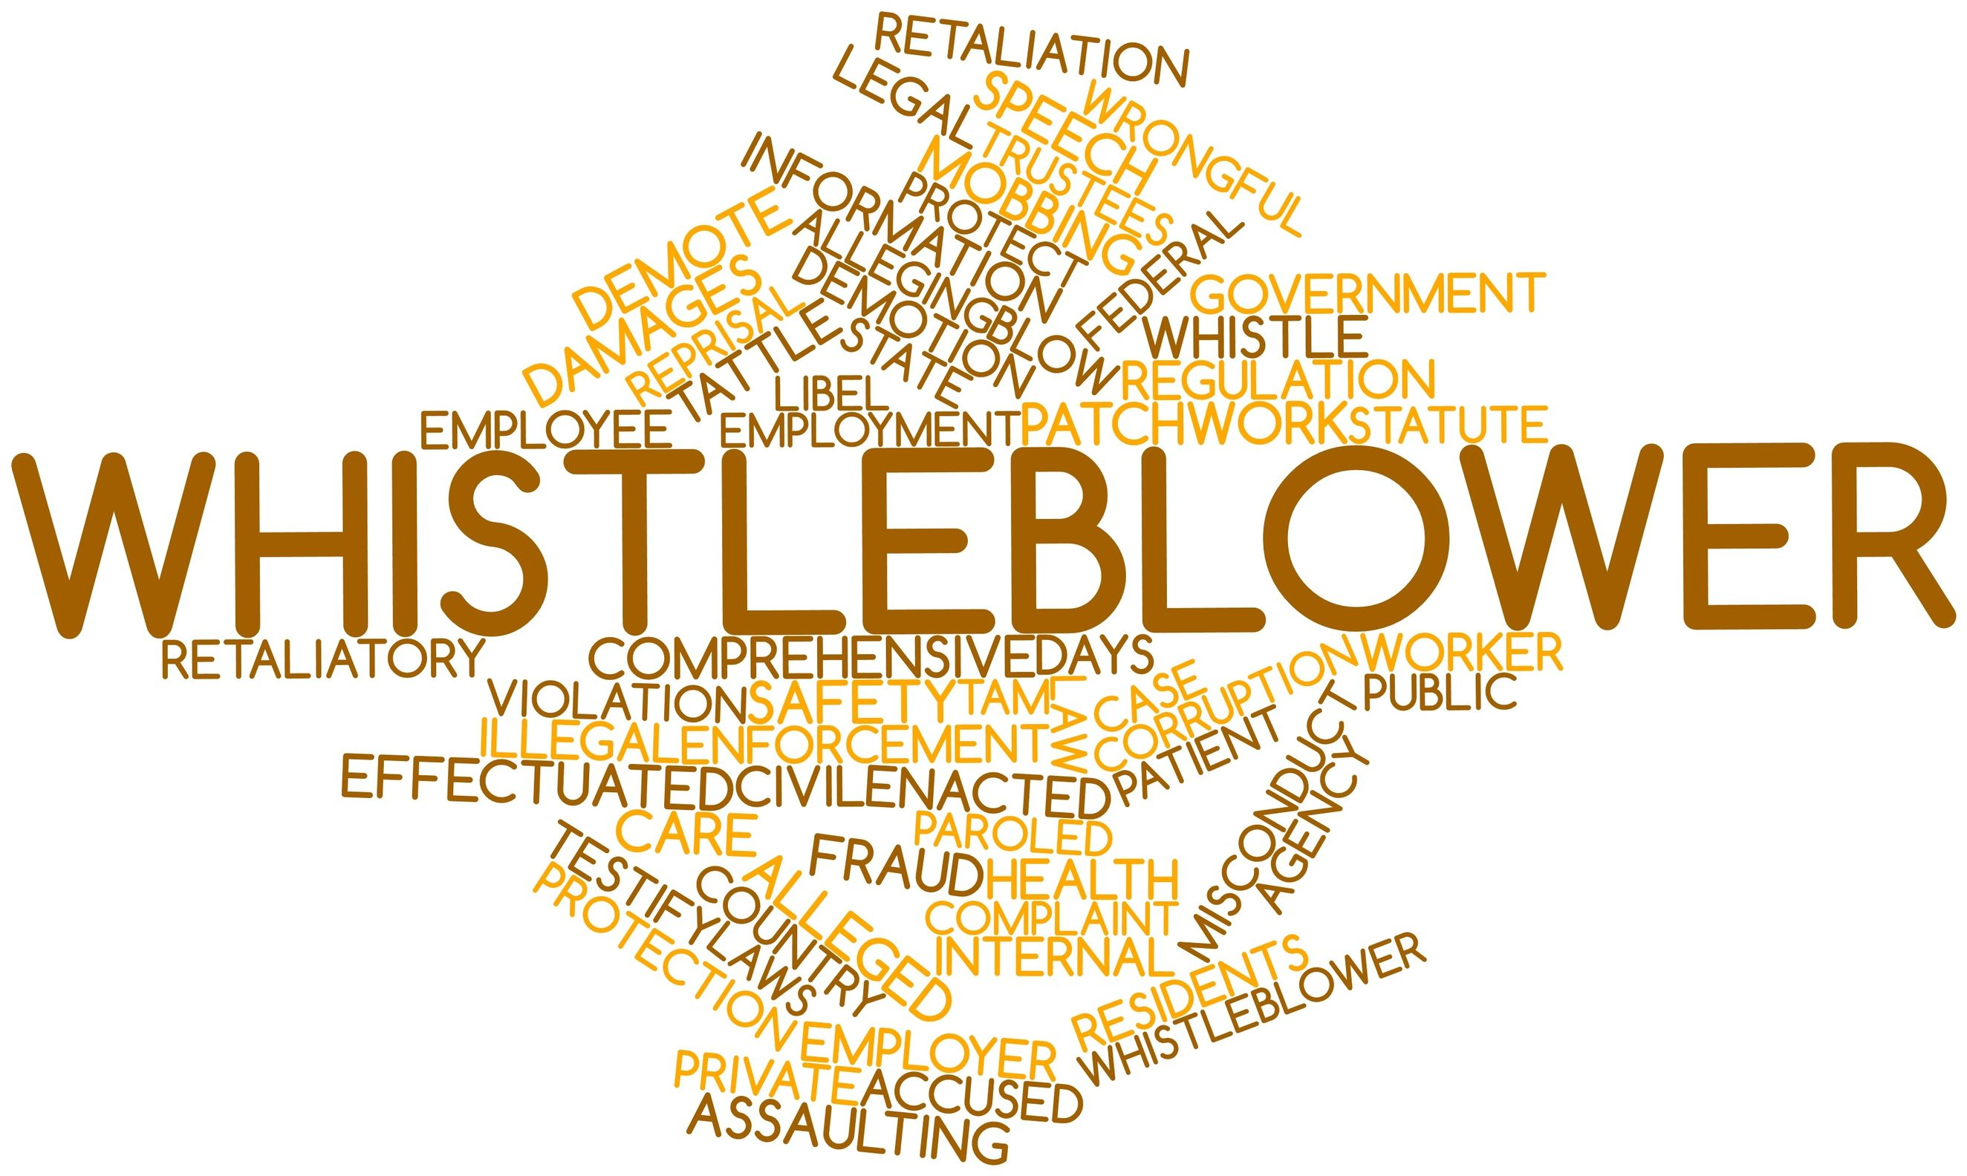
Legal Implications
Whistleblowers are normally protected from the law meaning you shouldn’t be treated unfairly or lose your job because you raised concerns of wrongdoings.
Legal implications can be both good and bad, so for Snowden due to his actions.
The only reason why Edward Snowden is not in Jail right now is due to the fact that Russia has provided him with right of asylum.
Change in law, warrantless surveillance program.

Slide 13
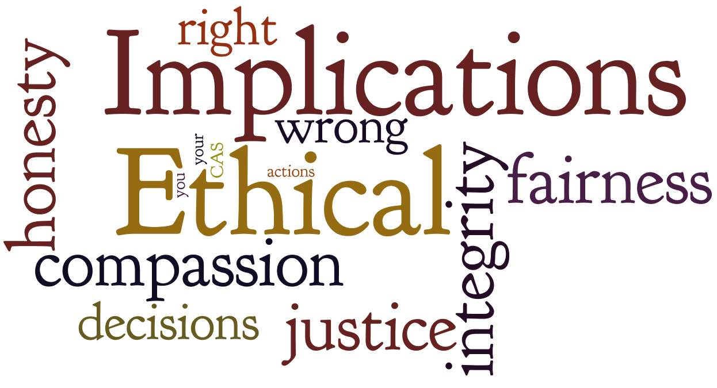
Ethical Implications
Some see the actions served out by Edward Snowden as good others bad.
Europe's privacy ruling. Robust privacy protections.
To do what is morally right will have backlash on big tech companies.
Whistle blowers punished more harshly than the alleged wrongdoers.
Ethical hacking surge.

Slide 14
Refences:
Anon., April, 1st 2017. Risual. [Online] Available at: https://www.risual.com/2017/04/01/the-war-on-cyber-crime-every-organisation-can-have-a-snowden/
Boadie, A., n.d. Reuters. [Online] Available at: https://www.reuters.com/article/us-internet-brazil/brazilian-congress-passes-internet-bill-of-rights-idUSBREA3M00Y20140423
Cassidy, J., June 10, 2013. The New Yorker. [Online] Available at: https://www.newyorker.com/news/john-cassidy/why-edward-snowden-is-a-hero
Finley, K., June, 10th 2015. Wired. [Online] Available at: https://www.wired.com/2015/10/tech-companies-can-blame-snowden-data-privacy-decision/
Grover, S., n.d. WhoIsHostingThis. [Online] Available at: https://www.whoishostingthis.com/blog/2015/05/20/snowdens-global-impact/
Guo, J., April 27, 2016. The Washington Post. [Online] Available at: https://www.washingtonpost.com/news/wonk/wp/2016/04/27/new-study-snowdens-disclosures-about-nsa-spying-had-a-scary-effect-on-free-speech/?utm_term=.7bcf59a24201
Heerden, S. v. S. &. R. v., March, 2015. Research Gate. [Online] Available at: https://www.researchgate.net/publication/275019554_The_Consequences_of_Edward_Snowden_NSA_Related_Information_Disclosures
Lewis, B., October 21st, 2016.. Embedded Computing Desing. [Online] Available at: http://embedded-computing.com/articles/edward-snowden-and-data-security-for-the-internet-of-things/
Reitman, C. C. a. R., June 2, 2015. Electronic Frontier Foundation (EFF). [Online] Available at: https://www.eff.org/deeplinks/2015/05/usa-freedom-act-passes-what-we-celebrate-what-we-mourn-and-where-we-go-here
Schnofeld, Z., Febuary 3th 2014. News Week. [Online] Available at: http://www.newsweek.com/most-americans-think-snowden-did-right-thing-poll-says-253163
Scott, M., June, 27th 2014. New York Times. [Online] Available at: https://www.nytimes.com/2014/06/27/business/angered-by-nsa-activities-germany-cancels-verizon-contract.html?_r=1
Sorkin, A. D., n.d. New Yorker. [Online] Available at: https://www.newyorker.com/news/amy-davidson/the-n-s-a-verizon-scandal

